Slide 1
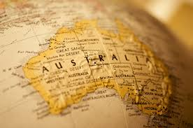
Making a Nation

Slide 2
Before white settlement……

Slide 3
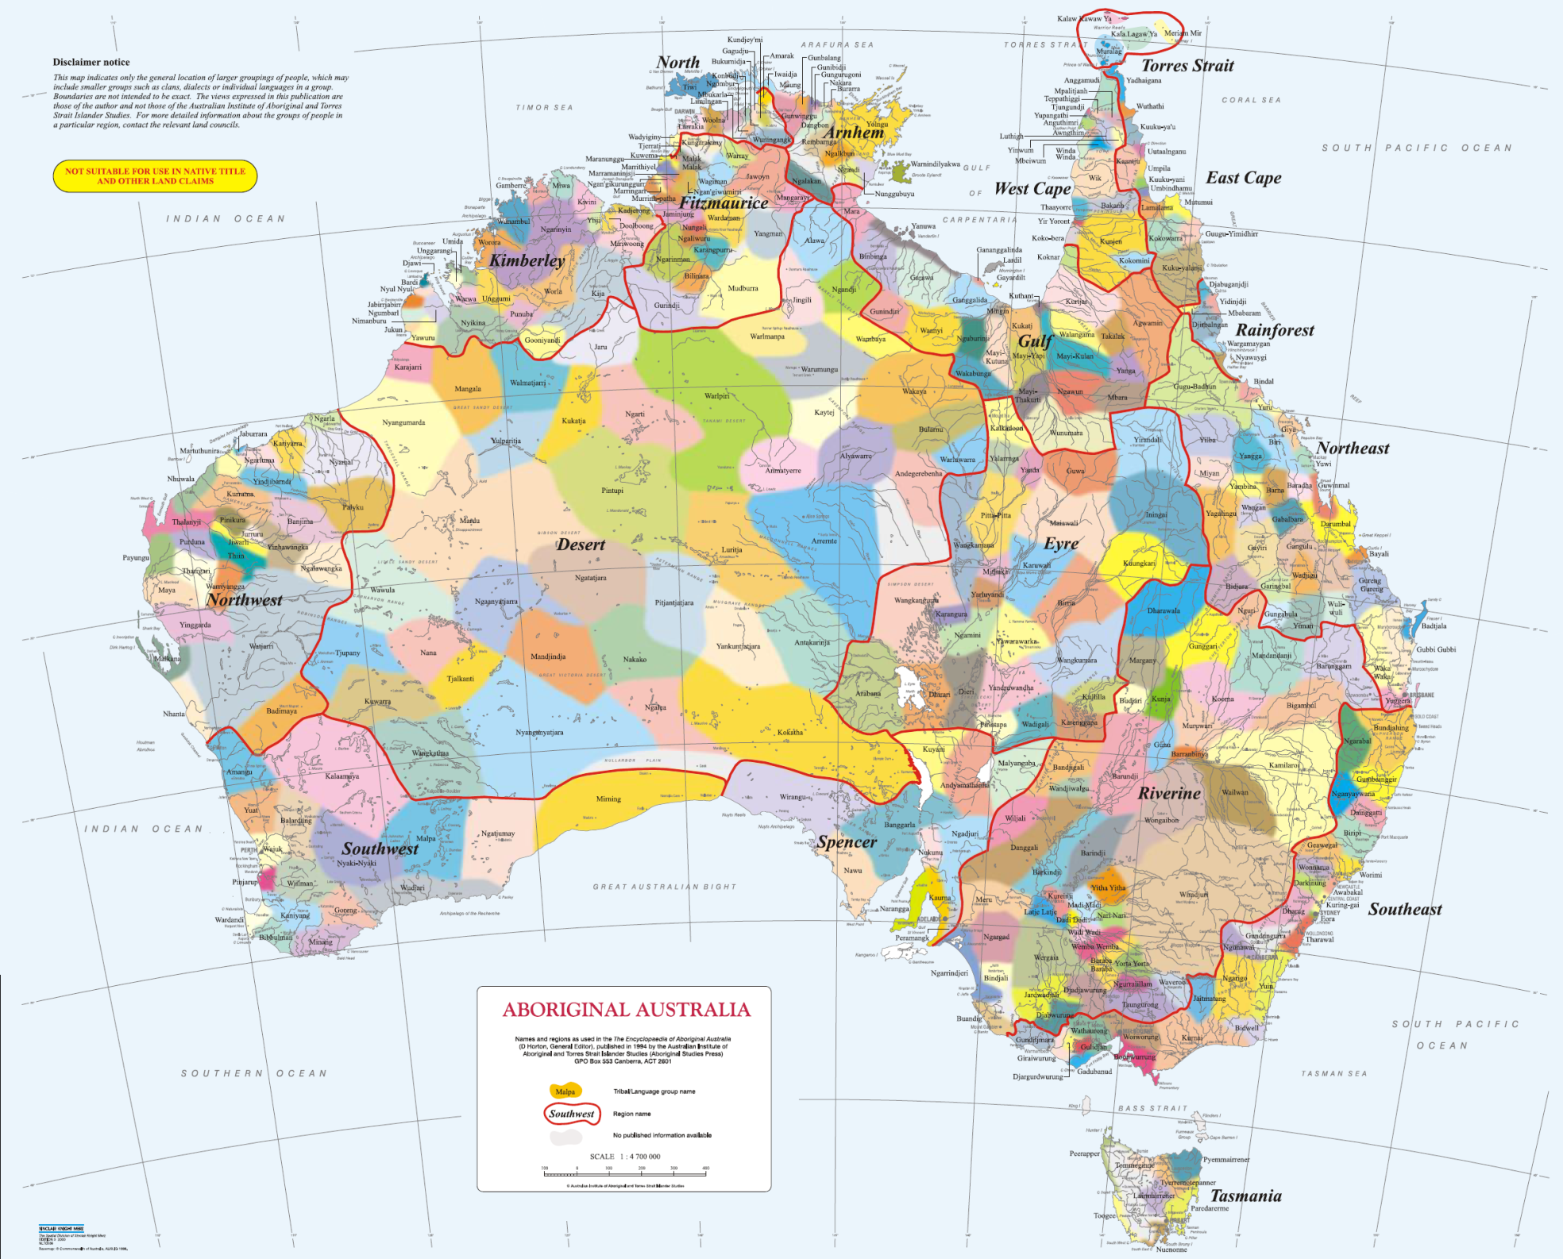

Slide 4
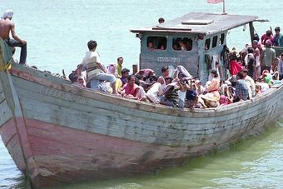
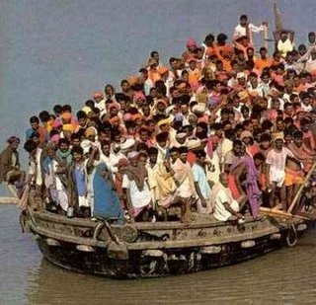
Boat People to Australia Present Day
What is your opinion about boat people coming to Australia?

Slide 5
In the beginning…..
The other boat people
Detail from Botany Bay; Sirius & Convoy going in ... 21 January 1788. from 'A Voyage to New South Wales'
by William Bradley, December 1786 - May 1792

Slide 6
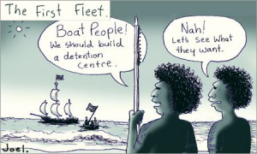

Slide 7
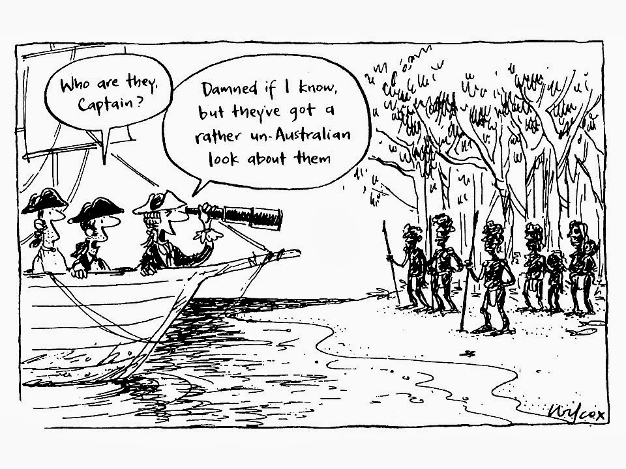

Slide 8
The Founding of Australia, Jan. 26th 1788, by Capt. Arthur Phillip R.N. Sydney Cove Original oil sketch [1937] by Algernon Talmadge R.A.

Slide 9
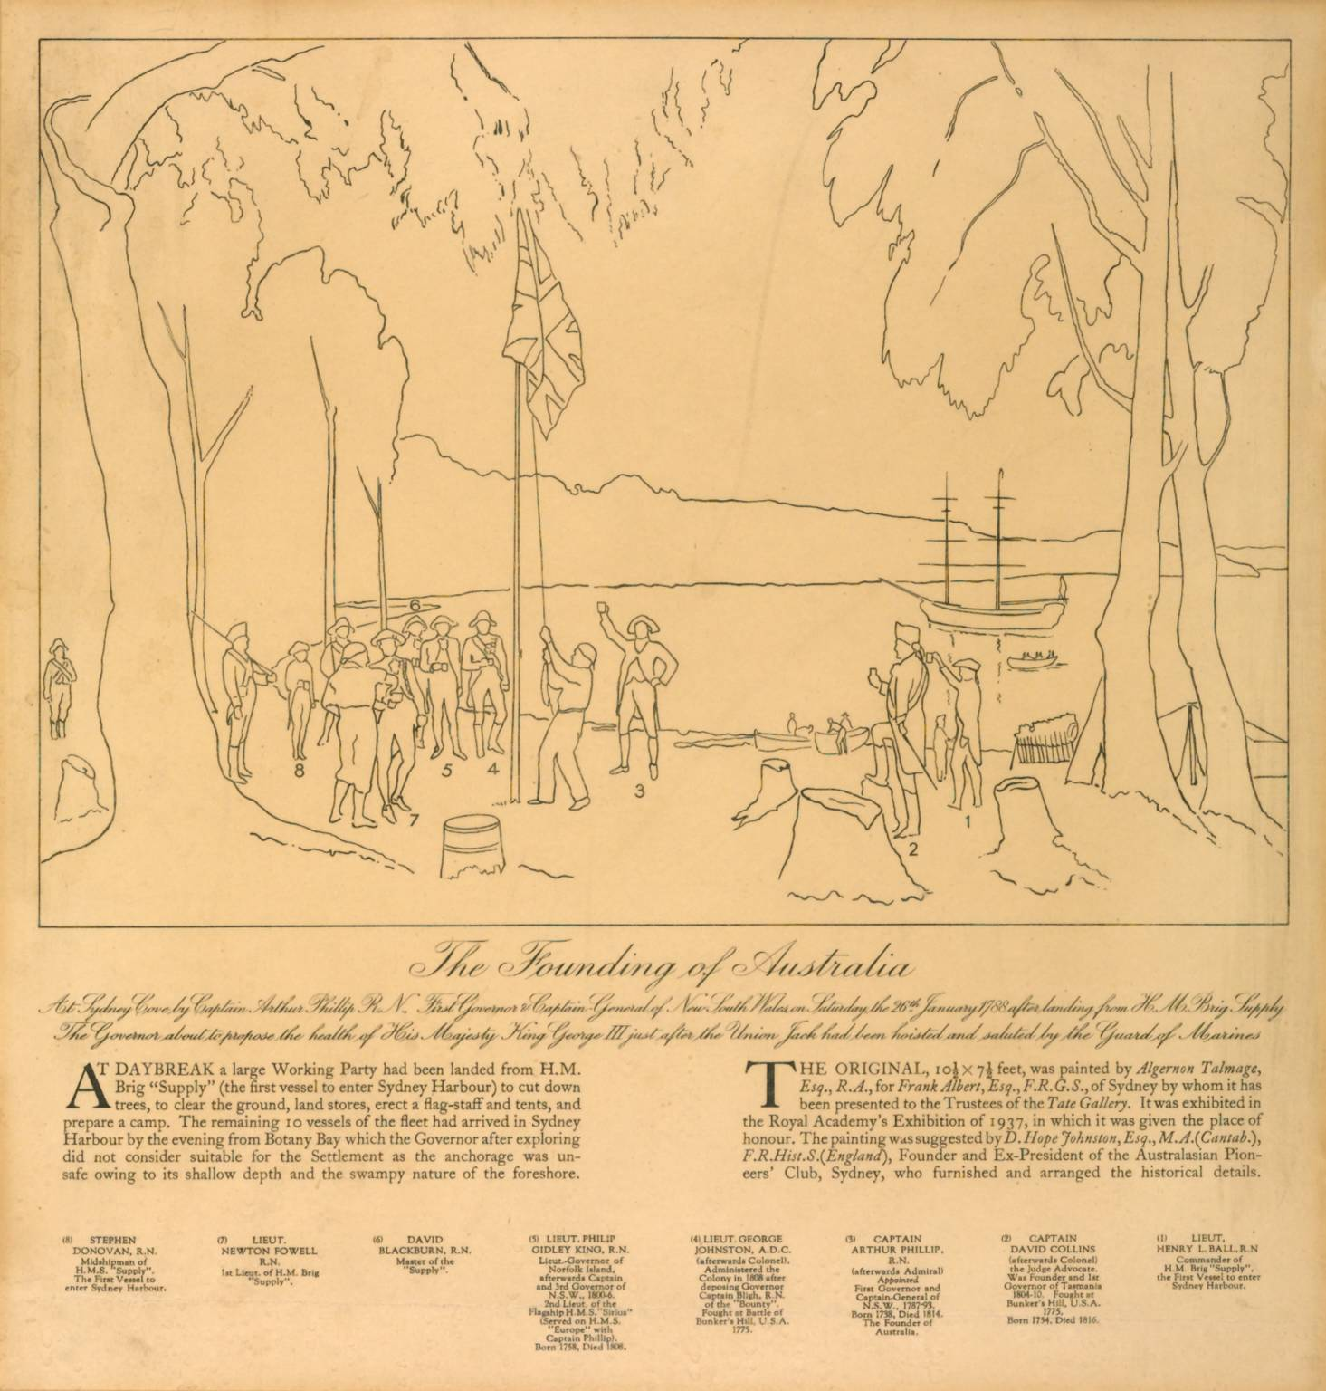
The original sketch

Slide 10
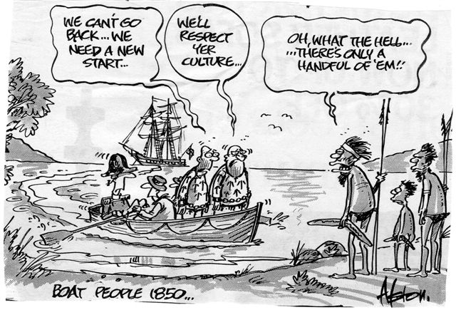
Perspectives
How do you think Aborigines would have reacted to the arrival of boats full of convicts ?
Like this?????

Slide 11
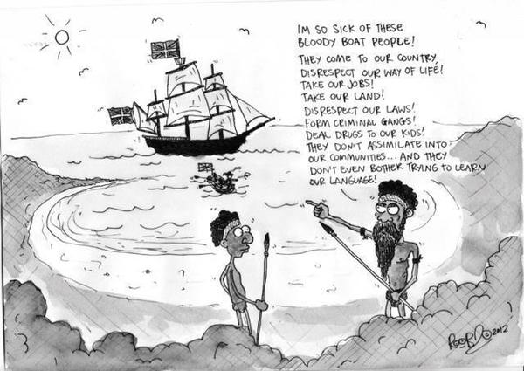
OR Maybe this???

Slide 12
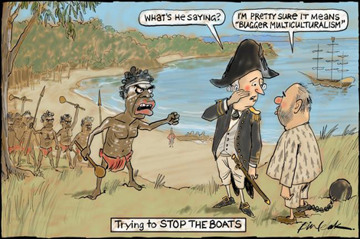

Slide 13
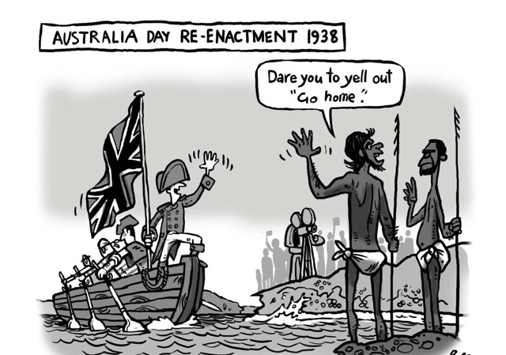

Slide 14
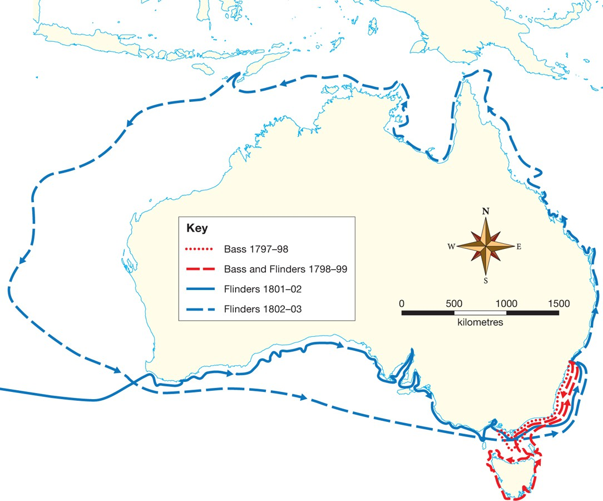
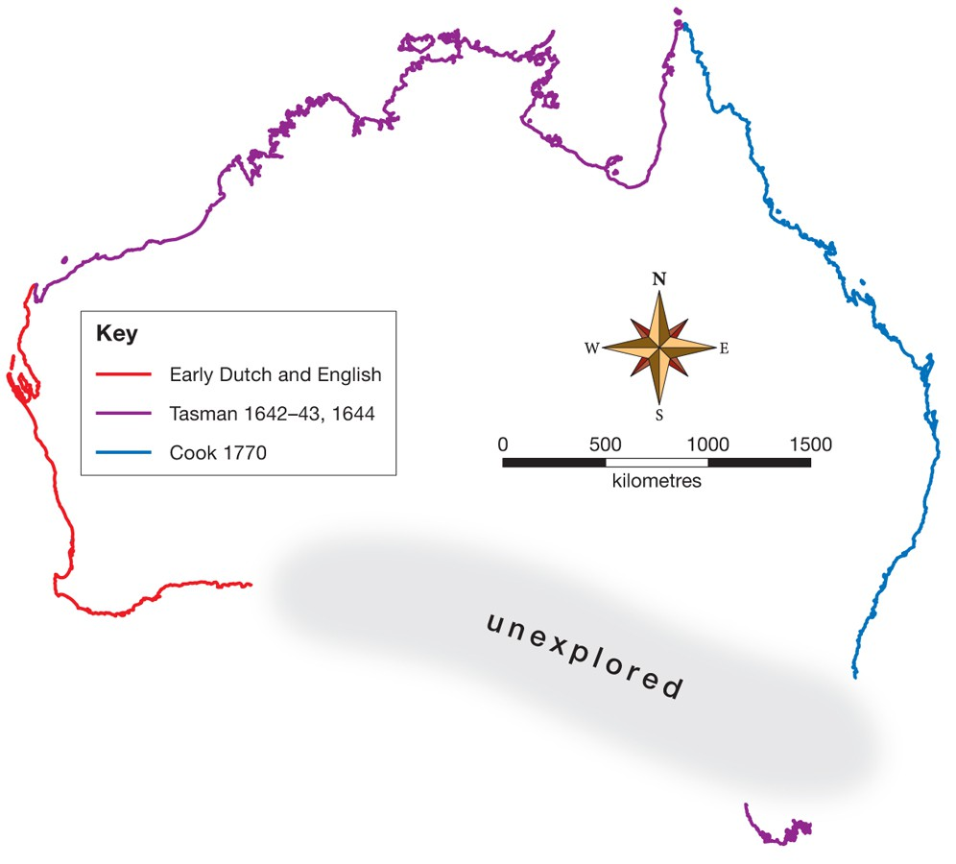
The extension of settlement
After the rest of the Australian continent was mapped by explorers, George Bass and Matthew Flinders, settlements around the Australian coastline cemented Britain's claim to the continent.

Slide 15
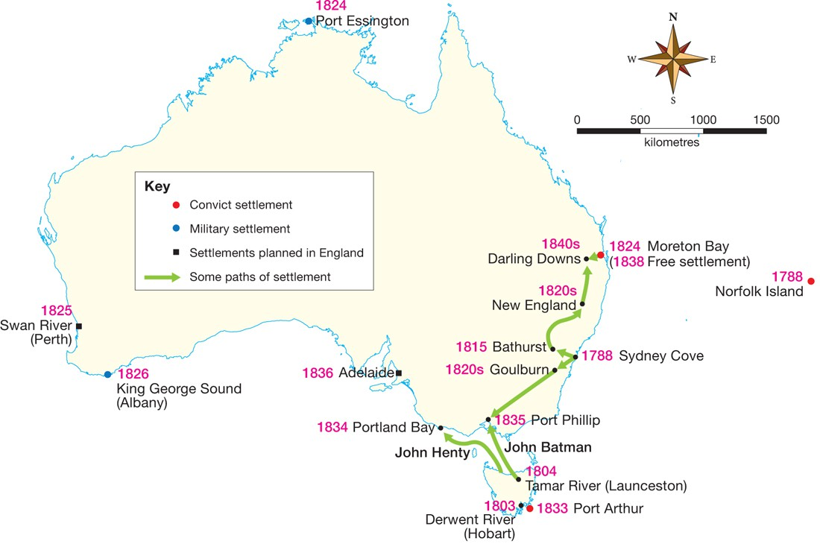
European settlement up to the 1850s

Slide 16
Early Settlements.....
- The British had little respect for, or understanding of, the Aboriginal
relationship to the land.
- They maintained that because the Indigenous Australians did not appear to
farm the land, the continent was terra nullius.
was used to justify their colonisation and settlement
Claiming of Australia took place in five different ways:
- sending parties out from Sydney to establish new settlements
- setting up military outposts at key points around the country to lay claim to the
continent
- establishing places of secondary punishment — new places to transport
convicts who were considered problems
- settlers moved outwards from settlements and claiming land as they went
- groups of people in England planning colonies of free settlers.

Slide 17
