Slide 1
Diplomacy – A Game of Alliances
Understanding the Alliances of WW1 Europe

Slide 2
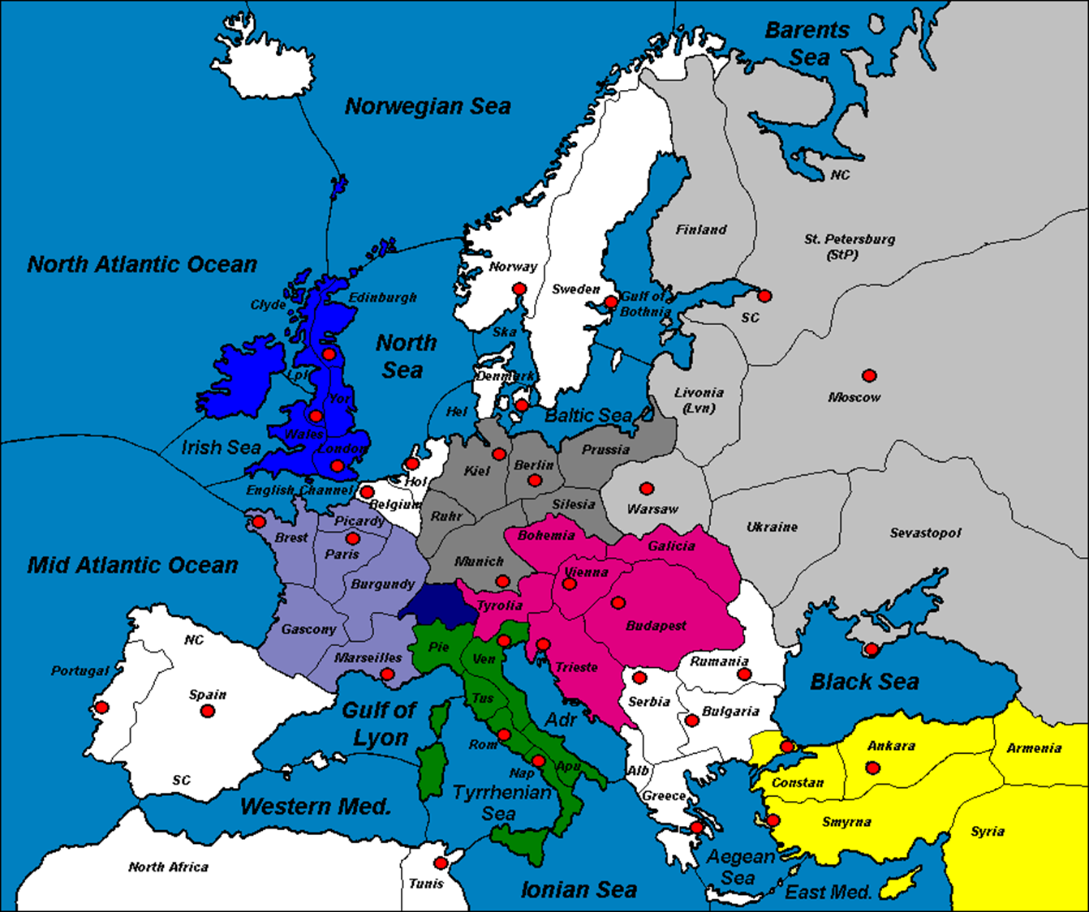
Why should we play Diplomacy?
Through playing Diplomacy, we will understand:
How Alliances contributed to the start of the war
The nature of the European Alliances
The inter-dependency necessary between European Powers during war efforts
The political map of Europe during WW1

Slide 3
Playing Diplomacy ~ Pre-Game Instructions
The class will be divided into 7 small teams, each of which comprises one of the great powers of Europe: England, Germany, Russia, Turkey, Austria-Hungary, Italy, and France.
Each country team will receive an information card and map, which includes information about your country’s alliances, as well as the opening moves your country must make, simulating some of the actions taken in the “war to end all wars”.
There will be four stages in this game, which represent the four seasons of the first year of war. When you have had time to talk to your fellow country representatives and familiarise yourself with your country’s alliances and objectives, the rules for the game will be laid out and the first stage will begin.

Slide 4
Diplomacy: Rules of the Game
France
Turkey
Each country’s forces begin in their country of origin. Each country will begin with a combination of armies and fleets. The number and starting positions are indicated on your country’s information cards.
There are four turns in this game. Each turn is broken up into two stages: negotiations and movement.
During negotiations, your country representatives will discuss the moves you will take in that turn, and secure any support your country needs from others in order to fulfil those objectives. Then, using a white-board marker, write these moves down on the back of your country card. Requirements for these objectives are outlined on your information card. You will be allowed five minutes for each negotiation period and to write your moves on the back of your country card. (note: all armies and fleets may move in a single turn).
After negotiations are completed, each team will indicate their moves on the game board by telling the teacher their moves when their country is called upon. Each army or fleet can only occupy or move one sea or territory at a time, however all of your armies and fleets may move in a single turn. The game board will be projected on the classroom whiteboard and bluetac will be used to position your armies and fleets.
Your country may need to attack an opposing country in order to secure an objective. In order to attack, simply write your attack down in the movement phase. However, you should only attack if you have more forces in surrounding territories, (this could include allied support). This support is why alliances are so important and where you will find the extra armies or fleets needed to secure your objectives.
If countries try to occupy the same territory at the same time, neither force can successfully occupy the territory unless they have support from an adjacent (next to) fleet or army. If neither country has such support, they must both move back (bounce) to the territory they came from. Note: Fleets may occupy and support coastal territories and waterways only, no land-locked territories. Further, neither can armies support fleets into other sea territories – unless they have Jesus boots.
The winning nations are those who fulfil all of their of their objectives – meaning, be a self-serving ally.

Slide 5
Diplomacy location abbreviations: when writing moves
Moves (simplified writing):
Identification of troop type (A – army, F – fleet) location of origin (First 3 letters) → arrow representing movement or attack location of destination (First 3 letters).
Types:
Move/attack
S Support a movement or attack
C Convoy (transport an army over water) *Fleets only
H Hold (don’t do anything)
Example:
F - MAO (Mid-Atlantic Ocean) → Por (Portugal)
A – Spa (Spain) S (support) F – MAO → Por *Fleet now has support for attack on Portugal

Slide 6
Legend:
Austria-Hungary
France
Italy
Germany
Great Britain
Russia
Turkey
Neutral

Slide 7
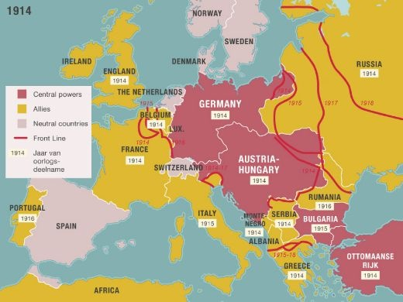
Diplomacy Reflection – Homework Task
What difficulties did you face in trying to achieve your objectives in the game?
What strategies did your country use in achieving your objectives?
How did your alliances help or hinder your ability to achieve your objectives?
Describe the major alliances and how they interacted during World War 1.
How do you think the Triple Alliance would have reacted to Italy’s betrayal?

